Slide 1

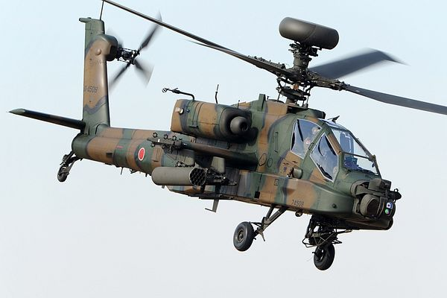
Heat Exchanger
for Demonstrator
ME476C
11-6-23
Uriah Whitaker: Team Lead
Dennis Decker: Manufacturing Engineer
Christopher Mason: Test Engineer
Lorenz Vios: CAD Engineer

Slide 2
Project Description
Project Description
Our project's primary objective is the design and creation of a liquid-to-liquid heat exchanger, with a strong emphasis on optimizing heat transfer efficiency. This advanced heat exchanger will be seamlessly integrated into a demonstrator, which serves as a practical representation of a helicopter cockpit, showcasing its ability to operate with a distinct refrigerant.
Sponsor
The project is sponsored by Boeing, a leading aerospace company. The significance of this project lies in its potential to revolutionize heat exchange technology within aviation, aligning with Boeing's commitment to innovation and efficiency in aircraft systems.
Importance
Environmental benefit:
Boeing is committed to transitioning from R-134a to R-1234yf, a more environmentally conscious refrigerant choice.
The noteworthy environmental benefit lies in R-1234yf, which has an environmental impact over 1,000 times lower in terms of climate change compared to R-134a. This transition represents a meaningful step toward sustainability.
- Safety:
It's important to note that R-1234yf, while environmentally friendly, possesses flammability risks.
The heat exchanger's vital role is to safeguard the cockpit from potential fires, ensuring the highest level of safety for both aircraft systems and personnel.
- Innovation:
This project serves as a testament to Boeing's unwavering dedication to innovation, a core principle driving their constant pursuit of advancements that enhance aircraft performance and sustainability.
The development of a more efficient and secure heat exchanger aligns perfectly with Boeing's commitment to pioneering aviation technology.
Uriah 11/7 BoeingHX F23toSp2405, 1

Slide 3
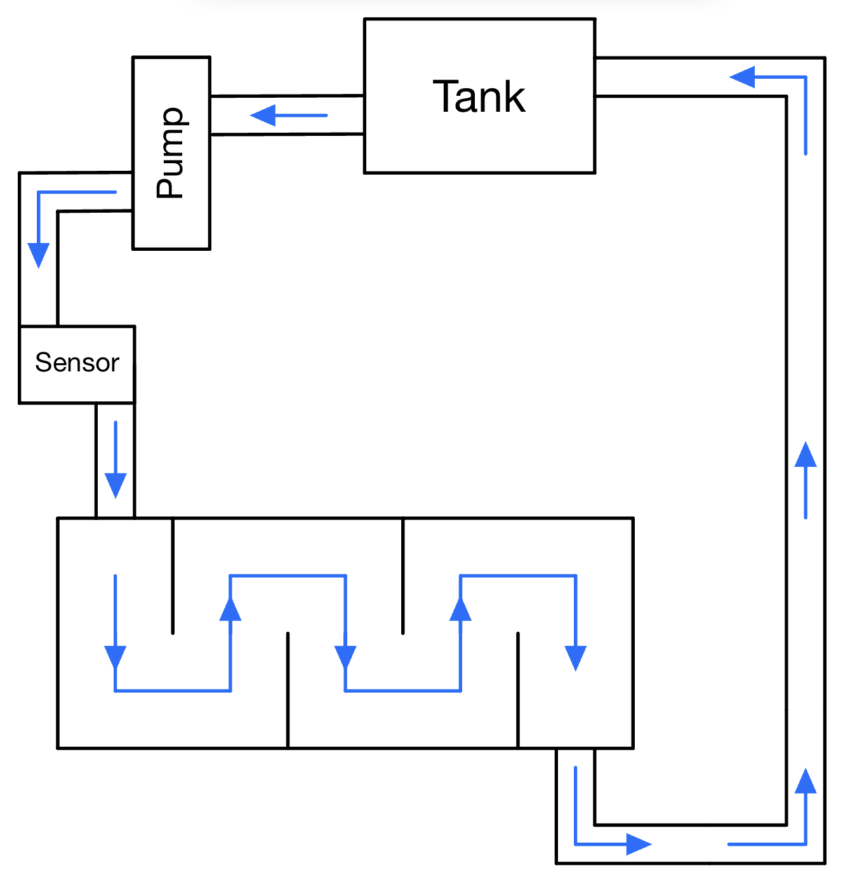
Flow Diagrams
Lorenz 11/7 BoeingHX F23toSp2405, 2
Fig 2. Ice Water Flow Diagram

Slide 4
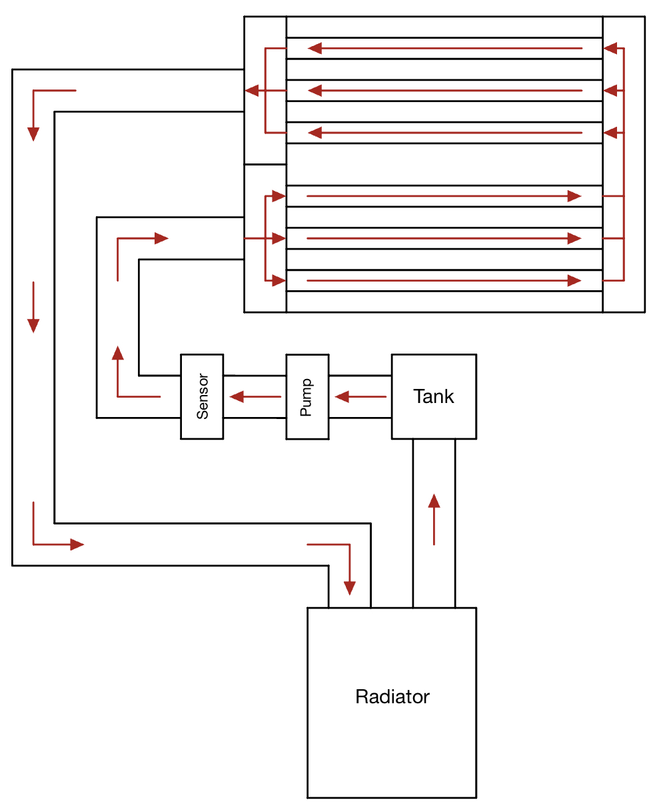
Flow Diagrams
Lorenz 11/7 BoeingHX F23toSp2405, 3
Fig 3. Coolant Flow Diagram

Slide 5
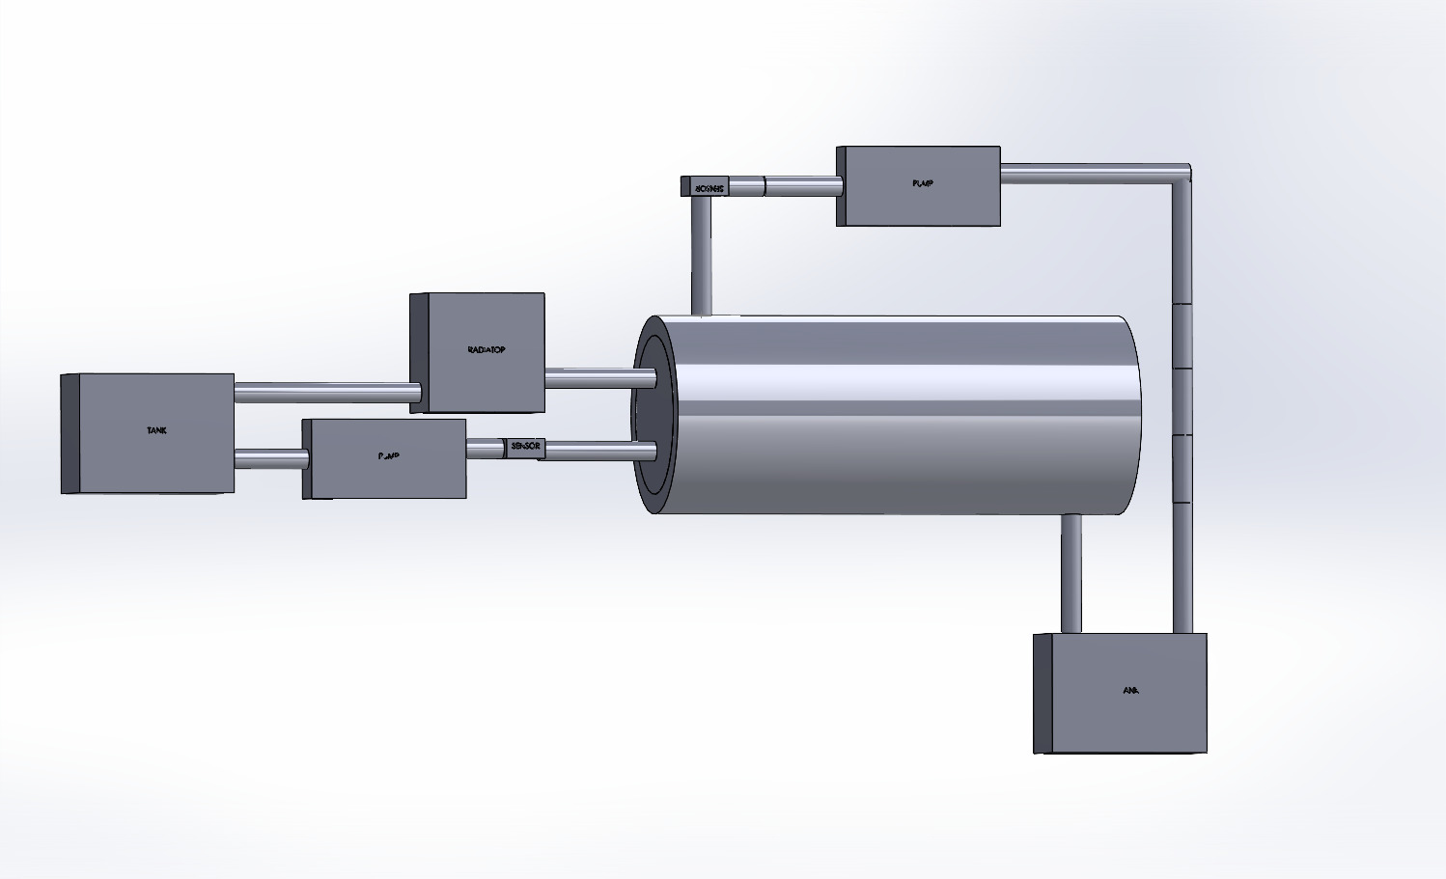
Overview of system
Uriah 11/7 BoeingHX F23toSp2405, 4
Fig 5. System Overview

Slide 6
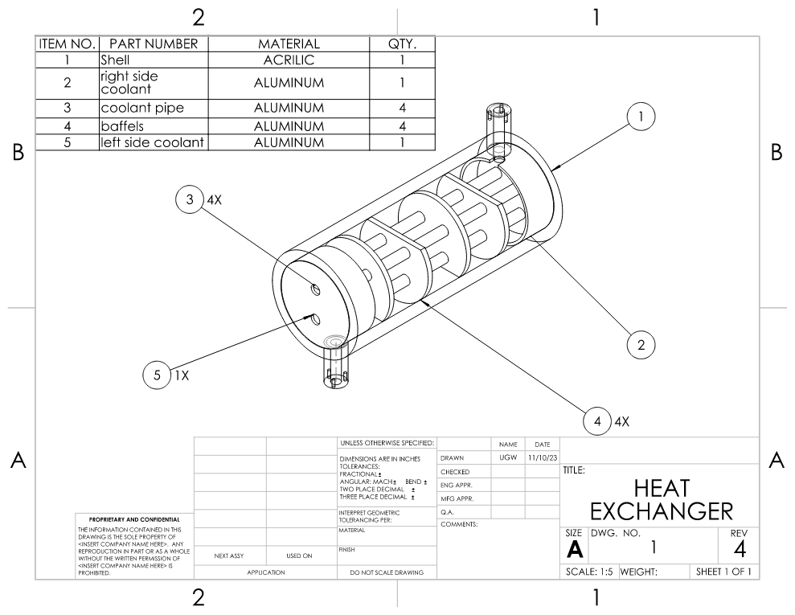
HXR Drawing with BOM
Uriah 11/7 BoeingHX F23toSp2405, 5
Fig 5. HXR Assembly Drawing

Slide 7
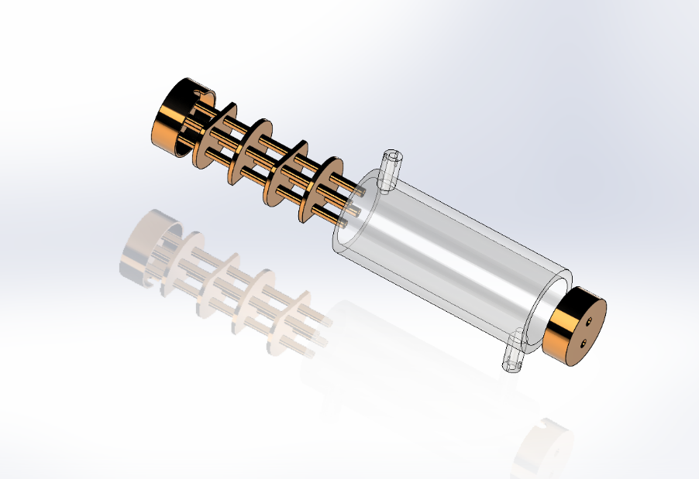
HXR Exploded View
Fig 4. Liquid-Liquid HXR Exploded View
Uriah 11/7 BoeingHX F23toSp2405, 6

Slide 8
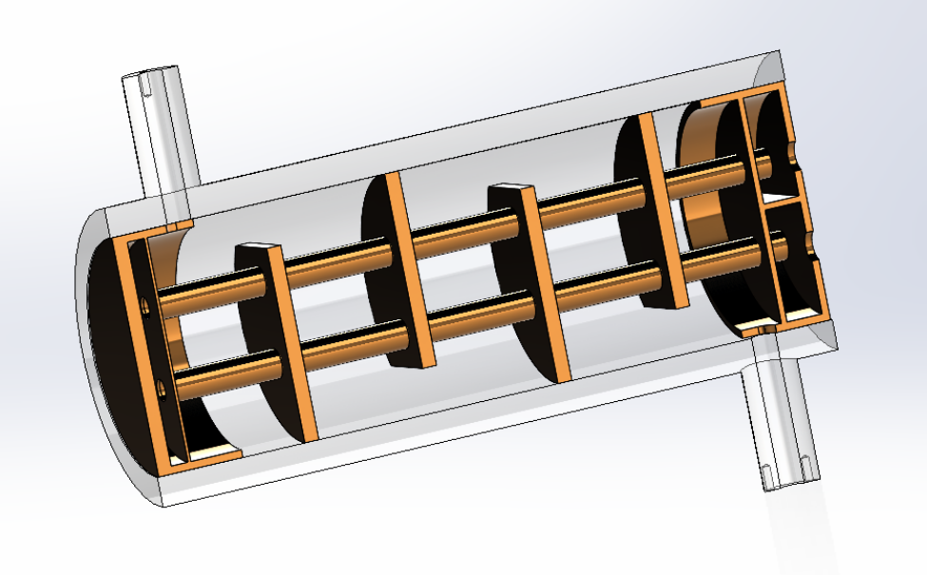
HXR Section View
Fig 5. Liquid-Liquid HXR Section View
Uriah 11/7 BoeingHX F23toSp2405, 7

Slide 9
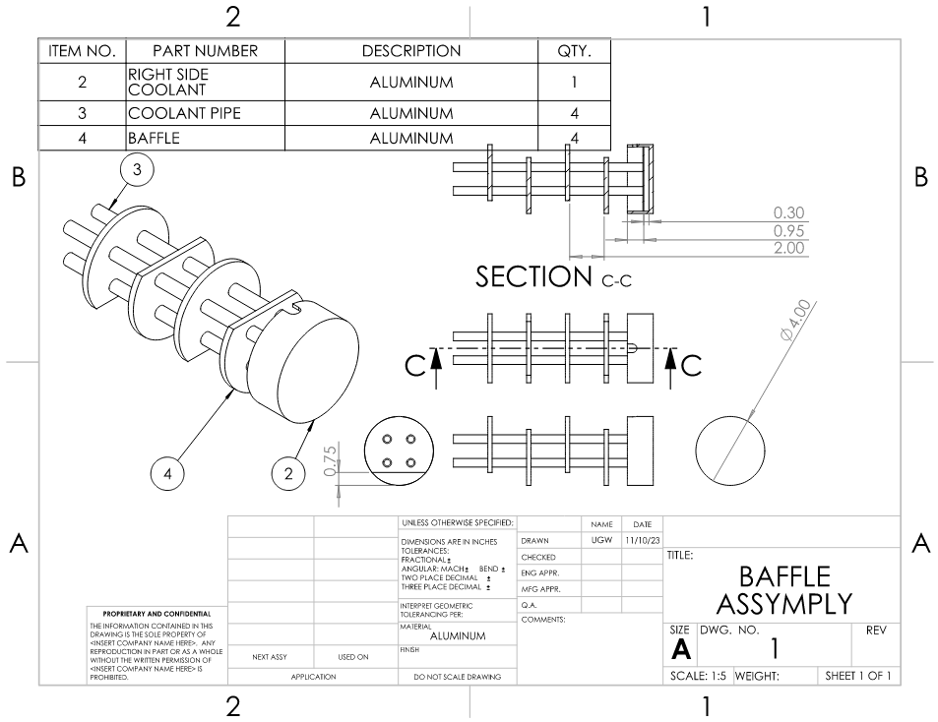
Baffle
Uriah 11/7 BoeingHX F23toSp2405, 8
Fig 5. Baffle Drawing

Slide 10
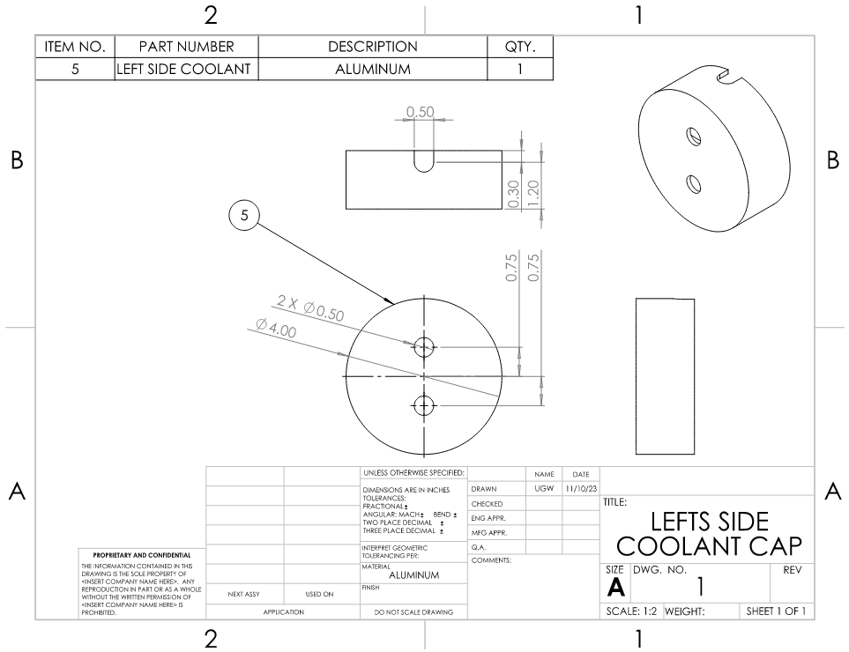
Left side coolant cap
Uriah 11/7 BoeingHX F23toSp2405, 9
Fig 5. Coolant Cap Drawing

Slide 11
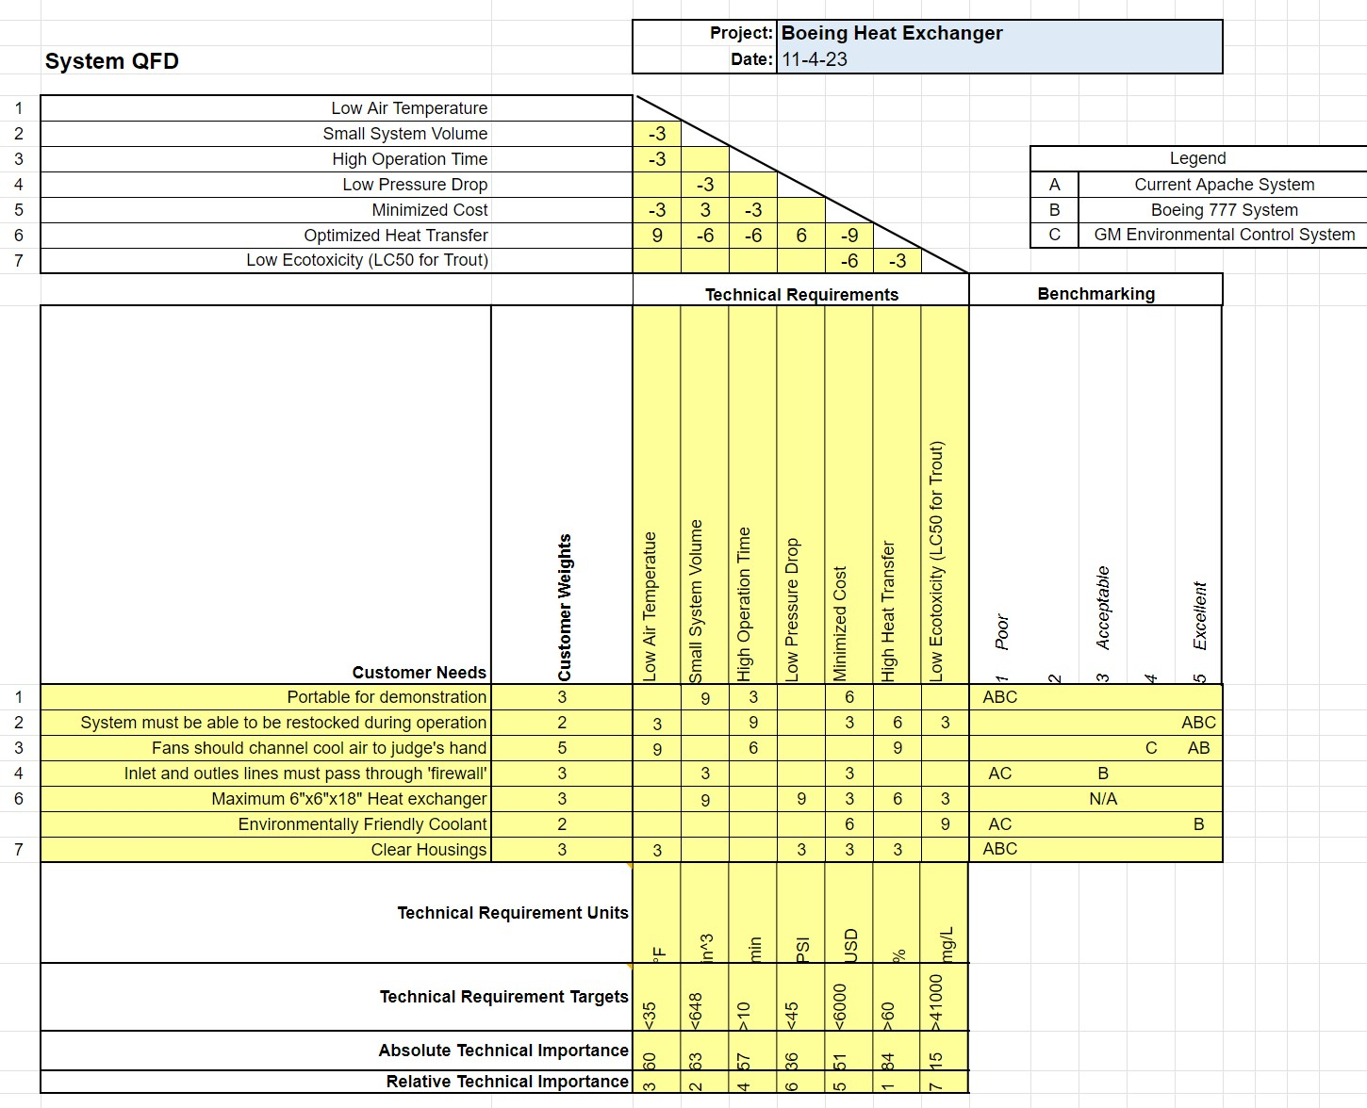
Updated Heat Exchange QFD
Dennis 11/7 BoeingHX F23toSp2405, 10
Figure 6. QFD Updated

Slide 12
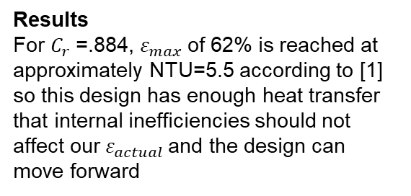

Updated Heat Transfer
Assumptions
T_{hi} is equal to ambient air temperature (𝞰=100% for radiator)
S.S. Flow
Adiabatic Heat Exchanger Shell
Negligible Kinetic and Potential energy effects
Negligible Thermal energy added due to pumps
HXR Parameters
2 Tubes with 2 passes
$3/8$ inch ID tubes
4 Inch ID Outer Shell
12 inch Tube length
NTU Method[1]
${Re}_{t}=\frac{⍴v_{h}d_{o}}{μ}=3459.13 ⇒$ ${Re}_{s}=\frac{⍴v_{c}d_{i}}{μ}=386.62 ⇒$ ${Nu}_{s}=.51{Re}_{s}^{.5}Pr^{1/3}=25.95$
$⇒$ $Nu_{t}=\frac{\left(f/8\right)\left(Re_{s}−1000\right)Pr}{1+12.7{\left(f/8\right)}^{{(1}/{2)}}(Pr^{{(2}/{3)}}−1)}=65.249 ⇒ {.6∗h}_{s}=\frac{{Nu}_{s}k}{d_{o}}=1266.85 \frac{W}{m^{2}K}$
$⇒$ $h_{t}=\frac{{Nu}_{s}k}{d_{i}}=2693.58 \frac{W}{m^{2}K} ⇒$ $U=\frac{1}{\frac{A_{o}}{A_{i}h_{t}}+\frac{A_{o}ln⁡({D_{o}}/{D_{i})}}{2πLk_{t}}+\frac{1}{h_{o}}}=832.68\frac{W}{m^{2}K}⇒$ $NTU=\frac{UA}{C_{min}}=24.72$
$⇒$ $C_{r}=\frac{C_{min}}{C_{max}}=.884 ⇒ ε=2\{1+C_{r}+\left(1+C_{r}^{2}\right)[\frac{1+exp[−(NTU)(1+C_{r}^{2})^{{(1}/{2)}}]}{1−exp[−(NTU)(1+C_{r}^{2})^{{(1}/{2)}}]}\}^{−1}=.621=62.1\%$
Thermally Undevelop flow and fluid leakage considerations
For turbulent flow the fully developed thermal region generally begins at L =10*ID. With 2 passes and 2 tubes we can consider the length of non thermally developed flow equal to L_{ud} =10*ID*2^2. So the length of fully developed flow can be found with L_{fd} = L_{t} – L_{ud}
To account for fluid leakage between baffles and flow outside of tube banks multiplying h_{s} by .6 to account for fluid leakage is generally accepted
Results
For $C_{r}$=.884, $ε_{max}$ of 62% is reached at approximately NTU=5.5 according to [1] so this design has enough heat transfer that internal inefficiencies should not affect our${ ε}_{actual }$and the design can move forward
Dennis 11/7 BoeingHX F23toSp2405, 11

Slide 13

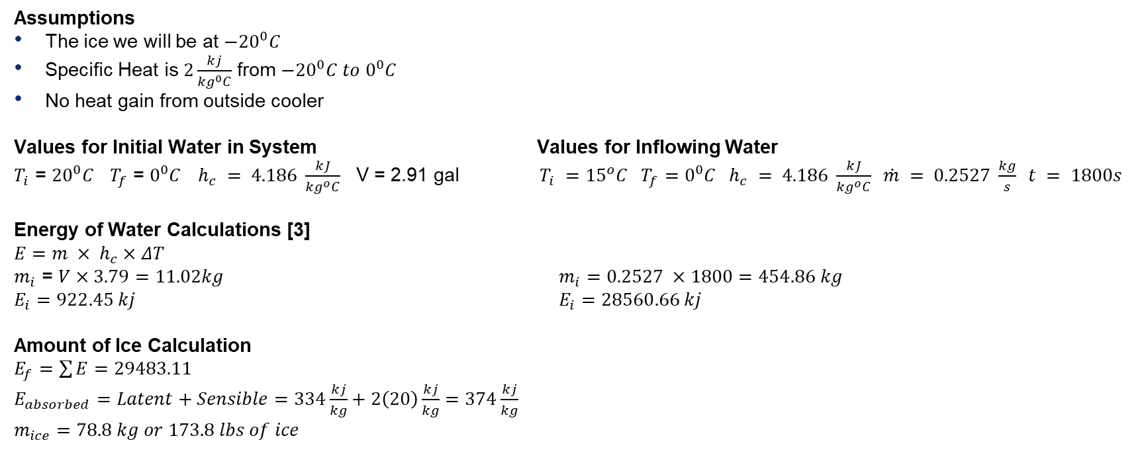
Ice Amount Including Sensible Heat
Assumptions
The ice we will be at ${−20}^{0}C$
Specific Heat is $2\frac{kj}{{kg}^{0}C}$ from ${−20}^{0}C to 0^{0}C$
No heat gain from outside cooler
Values for Initial Water in System Values for Inflowing Water​
$T_{i}$ = ${20}^{0}C$ $T_{f}$ = $0^{0}C$ $h_{c} = 4.186 \frac{kJ}{{kg}^{o}C}$ V = 2.91 gal $T_{i} ={15}^{o}C T_{f}=0^{0}C{ h}_{c} = 4.186 \frac{kJ}{{kg}^{o}C} \dot{m} = 0.2527 \frac{kg}{s} t = 1800s​$
Energy of Water Calculations [3]
$E=m × h_{c}×ΔT$
$m_{i}$ = $V×3.79=11.02kg$ $m_{i}=0.2527 ×1800=454.86 kg$
$E_{i}=922.45 kj$ $E_{i}=28560.66 kj$
Amount of Ice Calculation
$E_{f}=\sum{E}=29483.11$
$E_{absorbed}=Latent+Sensible=334\frac{kj}{kg}+2\left(20\right)\frac{kj}{kg}=374\frac{kj}{kg}$
$$m_{ice}=78.8 kg or 173.8 lbs of ice$$
Chris 11/7 BoeingHX F23toSp2405, 12
Fig 8. Bag of Ice

Slide 14
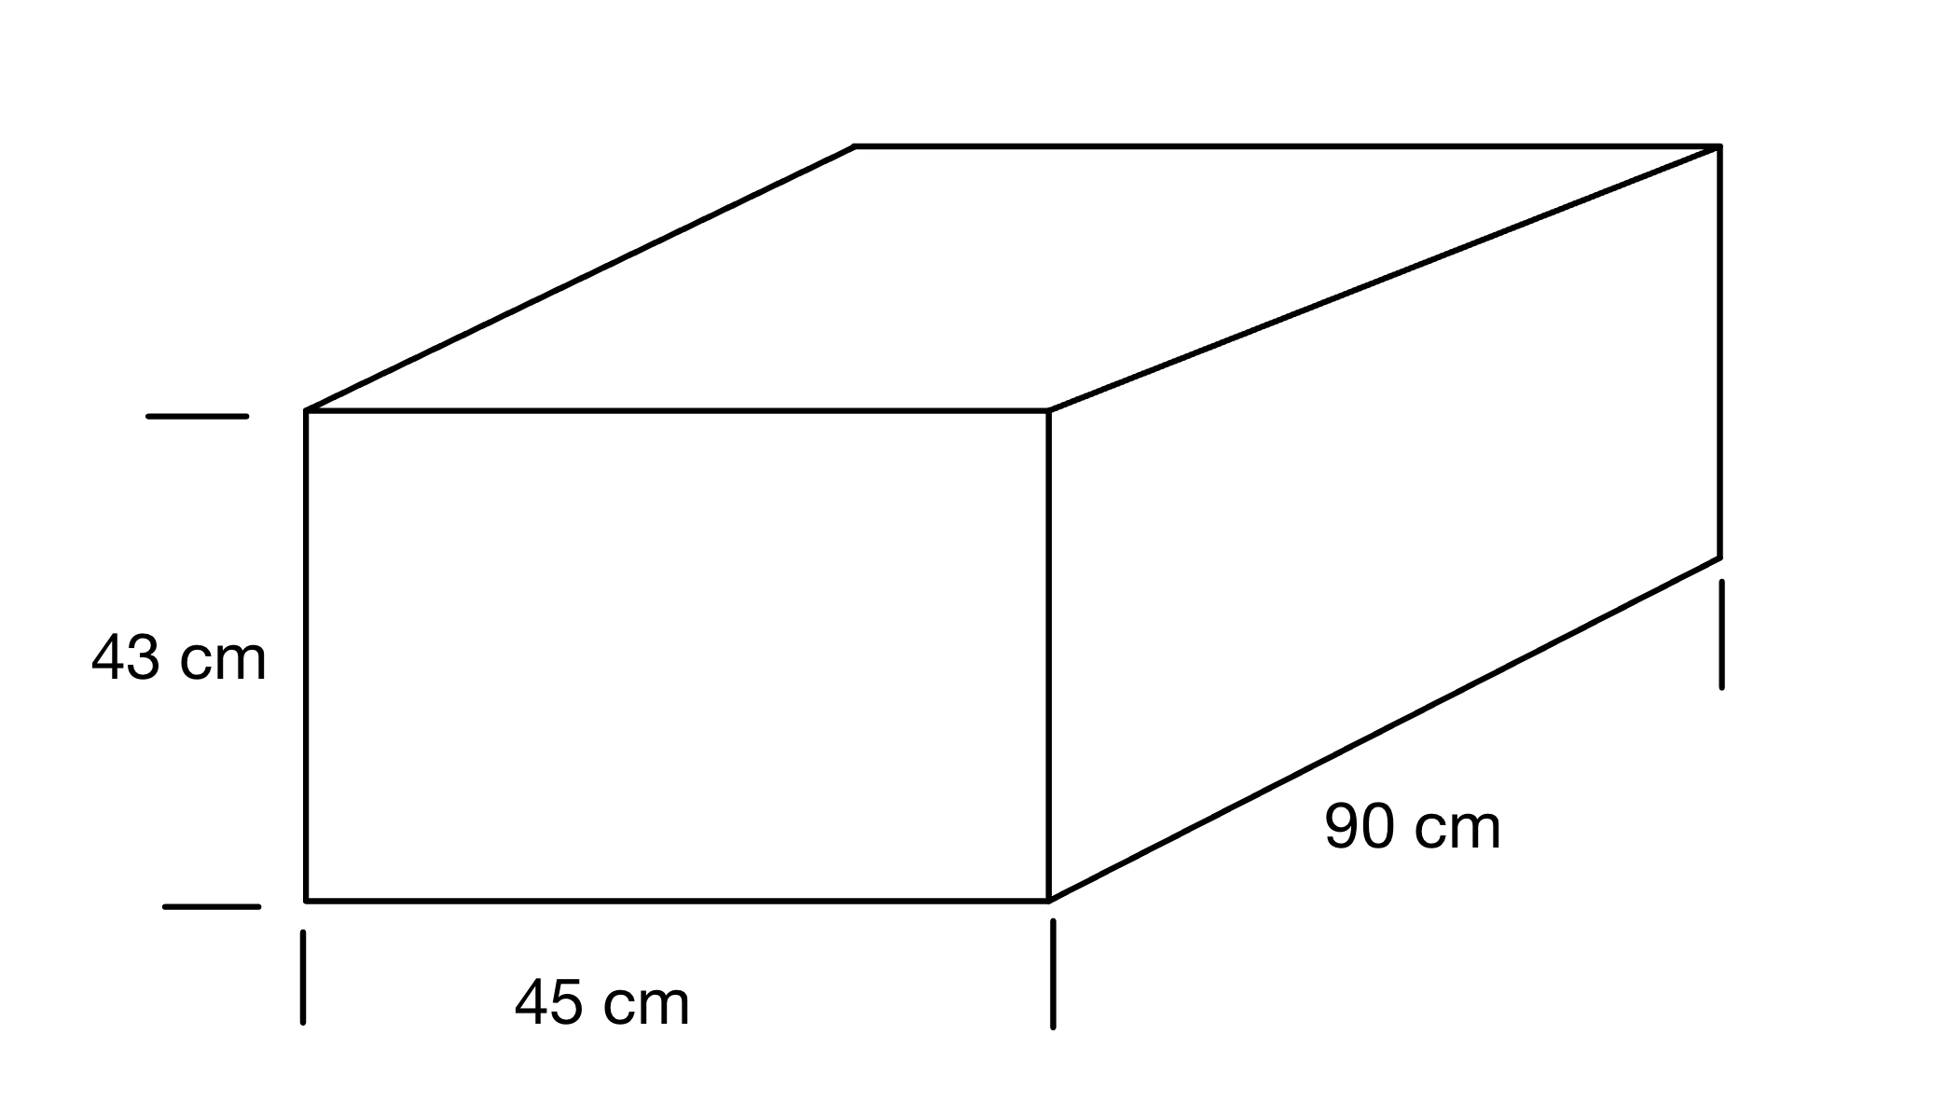
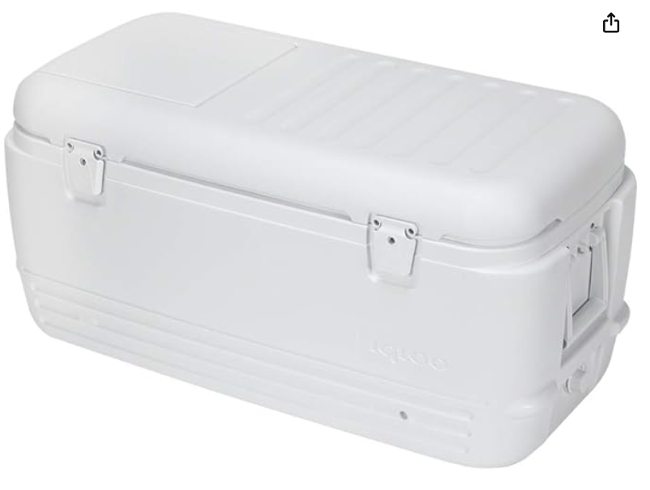
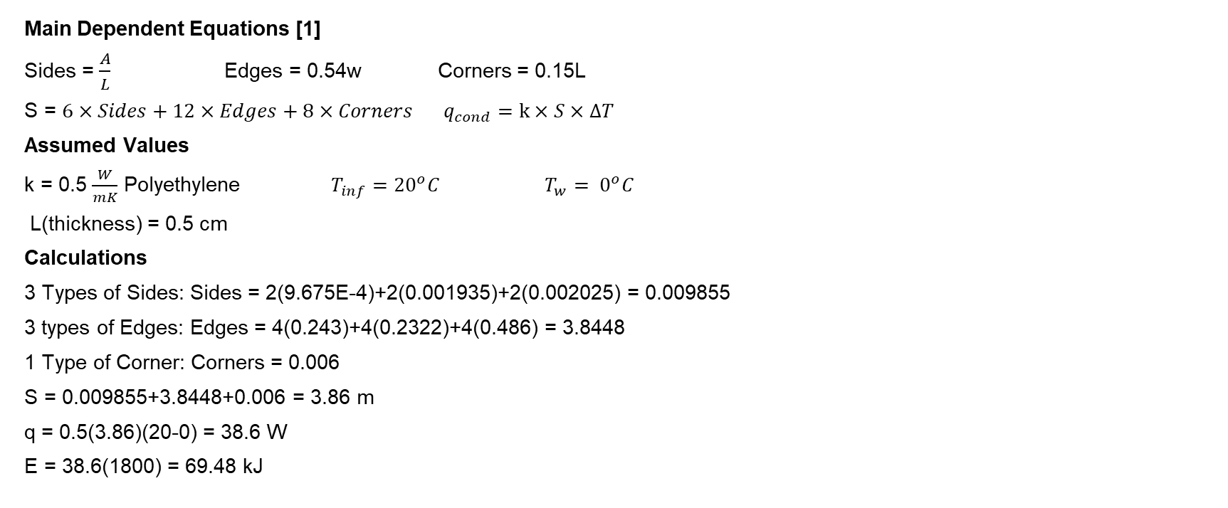
Cooler Heat Transfer With Shape Factors
Main Dependent Equations [1]
Sides = $\frac{A}{L}$ Edges = 0.54w Corners = 0.15L
S = $6×Sides+12×Edges+8×Corners$ $q_{cond}=k×S×ΔT$
Assumed Values
k = 0.5 $\frac{W}{mK}$ Polyethylene $T_{inf}={20}^{o}C$ $T_{w}= 0^{o}C$
L(thickness) = 0.5 cm
Calculations
3 Types of Sides: Sides = 2(9.675E-4)+2(0.001935)+2(0.002025) = 0.009855
3 types of Edges: Edges = 4(0.243)+4(0.2322)+4(0.486) = 3.8448
1 Type of Corner: Corners = 0.006
S = 0.009855+3.8448+0.006 = 3.86 m
q = 0.5(3.86)(20-0) = 38.6 W
E = 38.6(1800) = 69.48 kJ
Fig 9. Cooler Diagram
Chris 11/7 BoeingHX F23toSp2405, 13
Fig 10. 100 qt Cooler

Slide 15
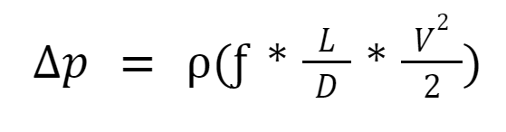
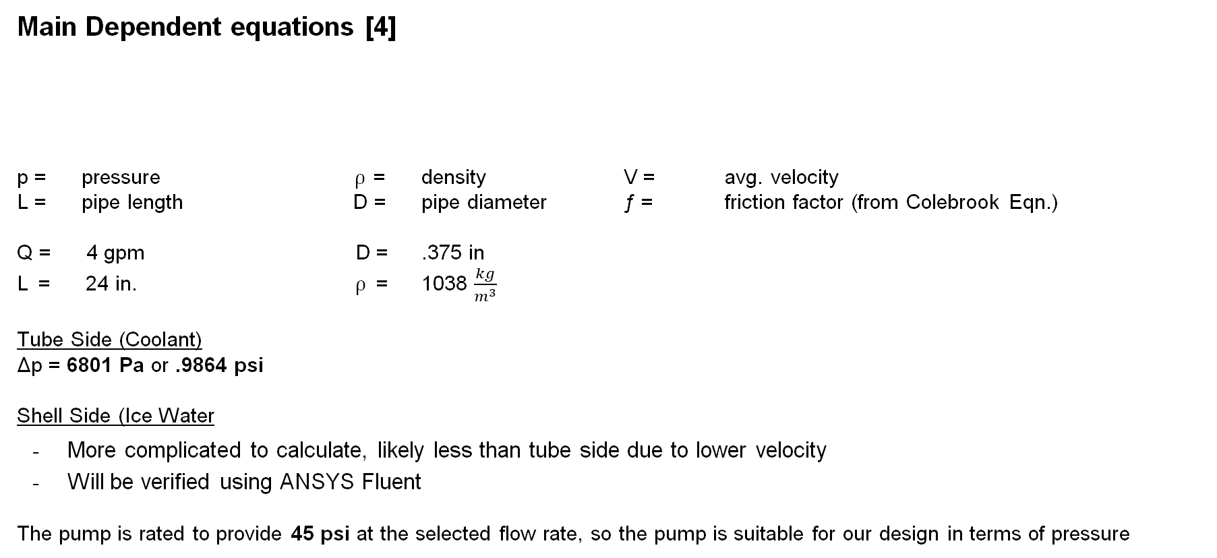
Pressure Drop Shell and Tube
Main Dependent equations [4]
p = pressure ⍴ = density V = avg. velocity
L = pipe length D = pipe diameter ƒ = friction factor (from Colebrook Eqn.)
Q = 4 gpm D = .375 in
L = 24 in. ⍴ = 1038 $\frac{kg}{m^{3}}$
Tube Side (Coolant)
Δp = 6801 Pa or .9864 psi
Shell Side (Ice Water
More complicated to calculate, likely less than tube side due to lower velocity
Will be verified using ANSYS Fluent
The pump is rated to provide 45 psi at the selected flow rate, so the pump is suitable for our design in terms of pressure
Lorenz 11/7 BoeingHX F23toSp2405, 14

Slide 16
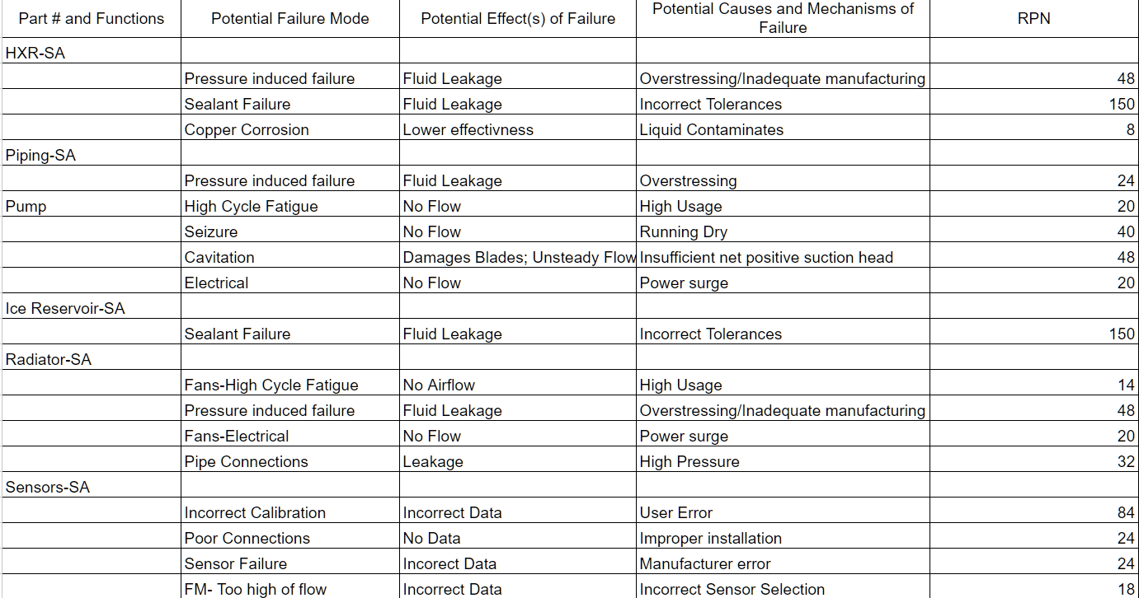
Failure Mode Analysis
Table 1. FMEA
Chris 11/7 BoeingHX F23toSp2405, 15

Slide 17
Testing Procedure
Validating Heat Transfer and Line Loss Analysis
Operate system over 30 minutes with required amount of ice
Flow sensors will measure the flow rates of each liquid loop
Thermocouples will measure inlet and outlet temperatures of the shell, tube, and radiator
Pressure transducers will take pressure readings at heat exchanger and radiator outlets
Thermocouples and pressure transducers will output signals to Arduino for display
Data will be compared with models to verify analysis accuracy
Dennis 11/7 BoeingHX F23toSp2405, 16

Slide 18
Budget
Table 3. Tentative Bill of Materials
Project Funding
$5,000 provided by Boeing
$1,000 provided by VA
Project Expenditures
$152 Testing Equipment (Thermocouples, Arduino, etc.)
$143.97 Backup/Replacement Parts
Total Income: $ 6,000.00
Known Expenses: $ 769.07
_______________________________
Available Capital: $ 5,230.93
Part Name | Qty | Unit Cost | Cost
Igloo Cooler | 1 | $98.99 | $98.99
Radiator | 1 | $22.99 | $22.99
Copper Tubing | 1 | $28.93 | $28.93
Pump | 2 | $68.99 | $137.98
Fan | 2 | $22.56 | $45.12
Acrylic Tube Shell | 1 | $51.99 | $51.99
Plastic Tubing | 1 | $11.49 | $11.49
Fan Power Supply | 1 | $15.95 | $15.95
Pump Power Supply | 1 | $14.91 | $14.91
Ice | 25 | $1.79 | $44.75
 |  | Total | $473.10
Lorenz 11/7 BoeingHX F23toSp2405, 17

Slide 19
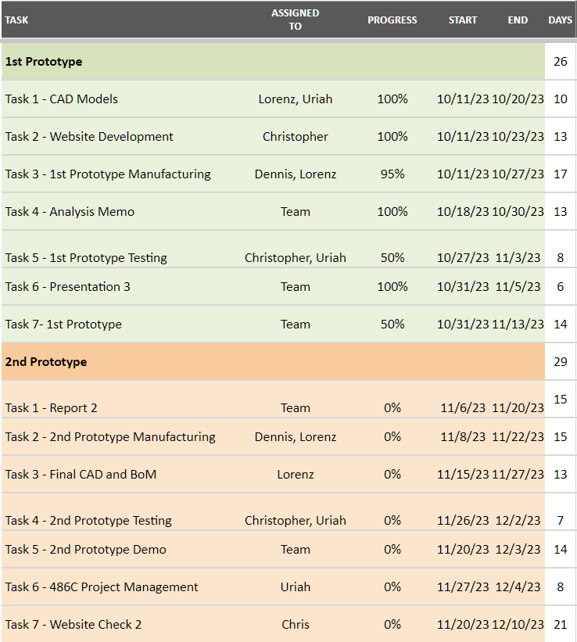
Schedule
Table 4. Gantt Chart - ME476C
Dennis 11/7 BoeingHX F23toSp2405, 18

Slide 20
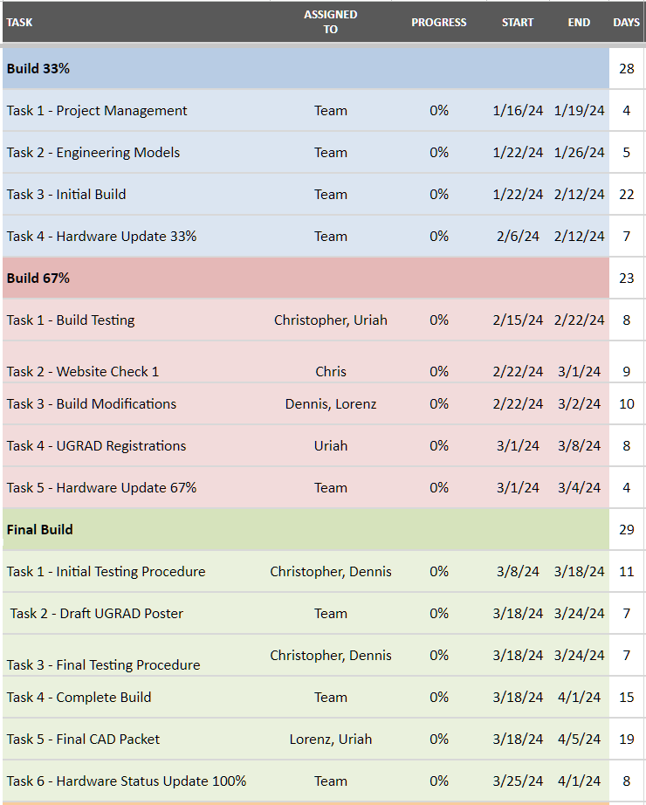

Schedule
Table 5. Gantt Chart - ME486C
Table 5. (cont.) Gantt Chart - ME486C
Lorenz 11/7 BoeingHX F23toSp2405, 19

Slide 21
Thank You

Slide 22
References
[1] T. L. BERGMAN, Fundamentals of heat and mass transfer, S.l.: WILEY, 2020
[2] tec-science, “Final temperature of mixtures (Richmann’s law),” tec-science, Jan. 20, 2021.
[3] R. W. Fox, Fox And Mcdonald’s Introduction To Fluid Mechanics. S.L.: John Wiley, 2020.

